Slide 1
Cloud Storage
Martirosyan Valeria

Slide 2
What is Cloud Storage?
Cloud storage is transforming data management by allowing information to be stored remotely on servers accessible via the Internet. Instead of storing files on physical devices such as hard drives or USB flash drives, cloud storage allows data to be stored securely online. This allows you to access, manage, and share information from anywhere and across devices. Cloud storage improves collaboration by allowing multiple users to work on the same files at the same time. It also provides automatic backups and data protection, reducing the risk of data loss.

Slide 3
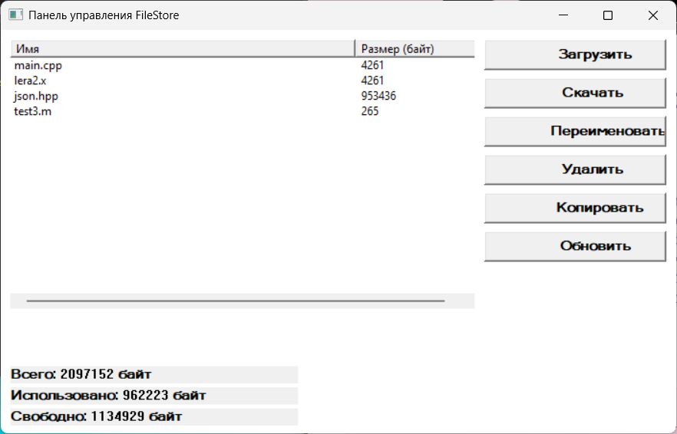

Slide 4

Cloud storage systems clearly display storage capacity information, including the total available space, the used storage, and the remaining free space. This allows users to easily monitor their data usage and manage storage resources efficiently.

Slide 5

What actions are available in cloud storage?
• Upload – moves files from a local device to a cloud storage for remote access.
• Download – retrieves files from the cloud and saves them to a local device.
• Copy – creates a copy of a file or folder in the cloud storage.
• Update – replaces an existing file with a newer version to keep the data up-to-date.
• Rename – changes the name of a file or folder without affecting its contents.
• Delete – removes files or folders from the cloud storage, usually with a restore option.

Slide 6
What technologies were used in creating the program?
C++
For implementing the program's core functionality
Elements involved
WIN32 interface API
Nlohmann/JSON library

Slide 7


Contains the following software modules .main.cpp The file main.cpp is the entry point of the program. It contains the main() function, which starts the application and processes user commands. This file connects the user input with the storage management logic. .StorageManager.h The file StorageManager.h defines the StorageManager class. It declares the methods used to manage files in the storage, such as upload, download, rename, update, and delete. .StorageManager.cpp The file StorageManager.cpp implements the methods declared in StorageManager.h. It contains the core logic for file operations and data handling. .FileRecord.h The file FileRecord.h defines the FileRecord structure. It is used to store file information, such as file name, size, and other metadata.

Slide 8

Conclusions
Cloud storage is a transformative technology enabling flexible, scalable, and secure data solutions. Understanding provider capabilities, core operations, and addressing challenges equips organizations to leverage cloud storage effectively while adapting to future technological advancements and business needs.

